Slide 1

NGA World Port Index
SNPWG 18 Michael Kushla
3 December, 2014
UNCLASSIFIED
1

Slide 2
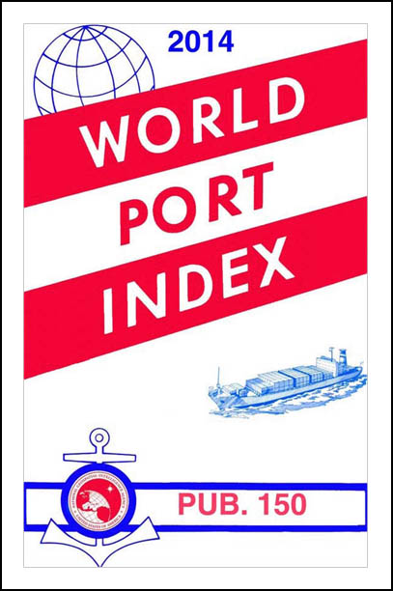
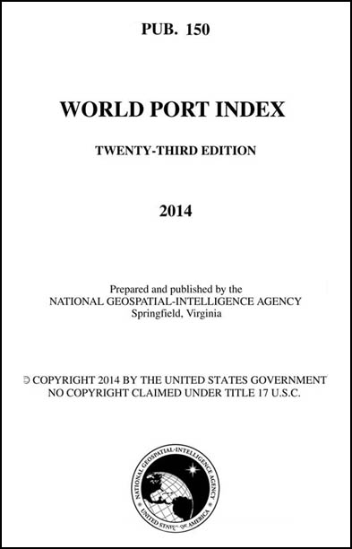
UNCLASSIFIED
2
UNCLASSIFIED

Slide 3
UNCLASSIFIED
Purpose of the World Port Index (WPI)
The World Port Index provides the location, characteristics, known facilities, and available services of a great many ports and shipping facilities and oil terminals throughout the world. The selection of these places is based on criteria established by NGA and are not random choices.
• Contains information on 3,700 ports, shipping facilities, and oil terminals.
• Location, characteristics, known facilities, and available services.
• Ports with a depth of at least 4 meters are listed.
3
UNCLASSIFIED

Slide 4
UNCLASSIFIED
WPI Display Format
• Tabular format.
• 31 information categories.
• 71 columns of information.
• Information displayed in the following manner:
1. Y for Yes.
2. N for No.
3. Blank for No Information.
4. Code Key letters to describe depths, harbor size, harbor types, shelter afforded, vessel length parameters, repairs available, and size of dry docks and marine railways.
4
UNCLASSIFIED

Slide 5
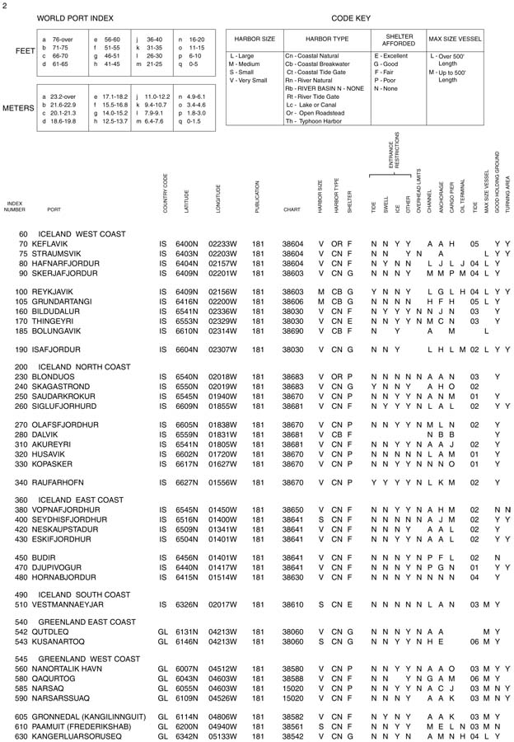
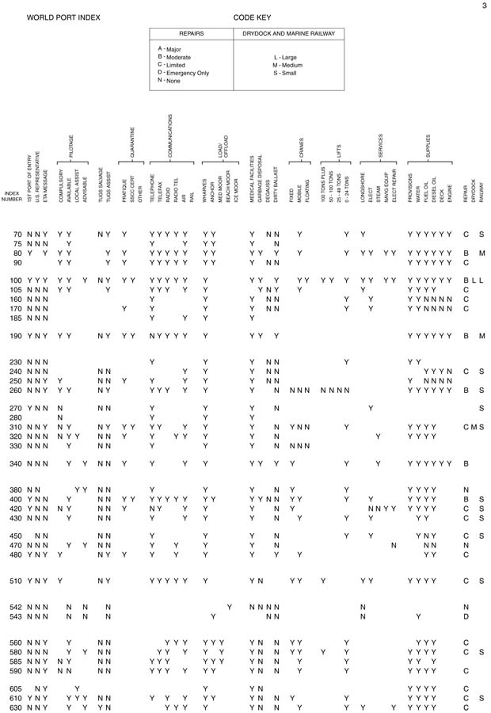

Slide 6
Difficulties using PDF Document
• Difficult to line up proper column and row.
Cannot easily line up proper column and row.
• Column heading difficult to read.
• Must correlate letter codes for depths, vessel size, harbor types, shelter afforded, and repairs with Code Keys at top of page.
• Due to size restrictions of the PDF, adding a new information column requires the elimination of a current column.
• Search function almost non-existent.

Slide 7
UNCLASSIFIED
WPI Access and Availability
The WPI can be downloaded from the NGA Maritime Safety web site in the following formats:
Adobe PDF document file.
Windows executable files (automatically installs Adobe PDF document file).
Microsoft Access data base.
Shape file.
7
UNCLASSIFIED

Slide 8
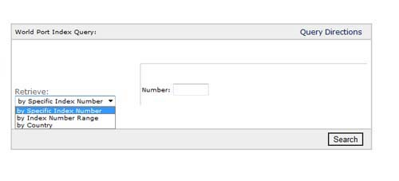
UNCLASSIFIED
On-line WPI Search Capabilities
Specific World Port Index entries can accessed only by the following choices:
By a specific World Port Index Number.
By a range of World Port Index Numbers.
By country.
8
UNCLASSIFIED

Slide 9
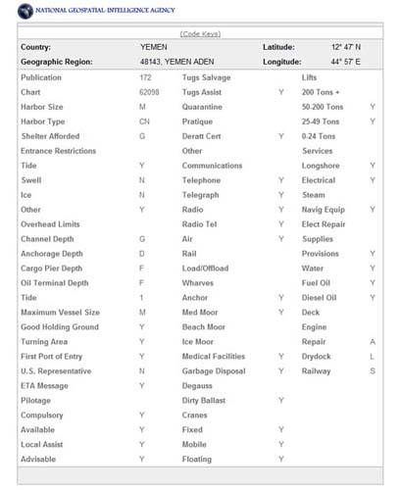
On-line Search Results
Easier to read than the PDF document.
Still need to use Code Keys to explain information.
Same limitations on adding new information as the PDF document.
No search capability beyond WPI number, range of WPI numbers, or country.

Slide 10
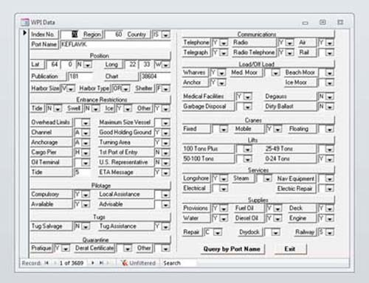
Access Search Results
Easier to read than the PDF document.
Still need to use Code Keys to explain information.
Same limitations on adding new information as the PDF document.
No search capability beyond port name, country, or region.

Slide 11
Shape File
1. Shows location of each port.
2. Click on locations to display port data (similar to Access view).
3. Still need to use Code Keys to explain information.
4. Users need to be familiar with GIS software and its functionality to make use of the information.
5. No other search capability.

Slide 12
What Are We Looking At Improving?
Information in a data base structure.
Output options in XML, HTML, PDF, and Shapefiles.
More robust search options.
Visual display of information.
User experience.

Slide 13
Information
What should stay?
What can be removed?
What needs to be added?

Slide 14
Information
Use of SNPWG Feature Dictionary with its associated attributes and definitions:
• Category of Marine Services (Vessel Traffic Service, Port Service, Ship Reporting Service, Broadcast Service)
• Port parameters (Maximum vessel draft and beam. Maximum/minimum vessel loa, displacement tons, dwt, gt, and nt.)
• Pilotage • Pilot Qualification • Remote Pilotage
• Category of Harbor Facility • Mooring Facilities
• Berthing Facilities (Total berths, visitors berths, berthing lengths)
• Overhead Limits • Anchoring (holding quality)
• Communications (Radio channels, telephone, facsimile, telex, telegraph, internet)
• Category of Supplies • Repair Services

Slide 15
More Robust Search Options
• General—WPI Number, port name, harbor type, harbor size, etc.
• Geographic—Position, bounding rectangle, ocean basin, country, etc.
• Vessel parameters—Type, size, loa, draft, beam, air draft, etc.
• Port/pier/facilities parameters—Type of facilities, limitations based on vessel parameters, etc.
• Port services—Medical facilities, water, bunkers, SSC/SSEC, etc.
• Port restrictions—Depths, vertical clearance, night transit, ice, underkeel requirements, etc.

Slide 16
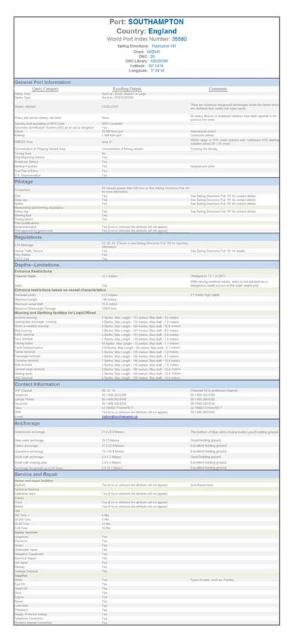
Sample Display
Better visual display of the information.
Better explanation of topics.
Elimination of Y, N, letter codes, and Code Keys.

Slide 17
End Result
Expanded information available.
More robust search options.
Better visual display of information.
Improved data input process.
Improved user experience.

Slide 18
Questions?
Comments?
Suggestions?
Insight?

Slide 19

UNCLASSIFIED
19
UNCLASSIFIED

